Slide 1

TEAM - 6
MAJOR PROJECT – I
WEB SCRAPING
Presented By
KANIMOZHI .E

Slide 2
PROJECT OBJECTIVE
TEAM - 6
Automate the collection of product reviews from Amazon and Flipkart.
Classify reviews as Positive, Neutral, or Negative using VADER(sentiment analysis).
Identify product strengths, weaknesses, common complaints, and praised features.
Perform aspect-based analysis for features such as camera, battery, display, and performance.
Visualize sentiment, ratings, review trends, and frequently mentioned terms.
Enable product and Amazon-vs-Flipkart comparison.
Provide data-backed insights for consumers and business users.

Slide 3
TECHNOLOGY USED
TEAM - 6
Frontend
React.js – Develops the interactive user dashboard.
Recharts – Displays sentiment, rating, and review trends through charts.
Axios – Connects the React frontend with backend APIs.
Backend
Python & Flask – Develops REST APIs and handles application logic.
Selenium – Performs dynamic web scraping from Amazon and Flipkart.
Beautiful Soup – Supports HTML parsing and data extraction.
VADER – Performs sentiment analysis and classifies reviews as Positive, Neutral, or Negative.
Pandas & NumPy – Handles and processes review datasets.
Deployment
Vercel – Frontend deployment.
Render – Backend deployment.
MongoDB Atlas – Cloud database.

Slide 4
TEAM - 6
SYSTEM WORKFLOW
start
Web(application)
Run the main file in vs code(PYTHON)
Flask----> Load data from CSV(python + Pandas)
Open’s the IMDB web
Using selenium(chrome web driver)
Open web interface(frontend) &JS fetches data from Flask API
Scraped details organized by using pandas(Title ,Year ,Rating ,Rank )
Display movie details (Rank . Title . Year . Rating)
Finally data will be stored in the CSV file
Responsive web interface

Slide 5
TEAM - 6
KEY FEATURES
Automated IMDb Scraping – Extracts movie data using Selenium.
Top 250 Movie Data – Collects rank, title, year, and IMDb rating.
Movie Search – Search movies by title.
Rating Filter – Filter movies based on minimum rating.
Structured Data Storage – Saves extracted data in CSV/Excel format.
Top rating Movies – Displays the top 10 highest-rated movies

Slide 6
TEAM - 6
RESULT
Automated Data Extraction – Successfully extracts IMDb movie details using Selenium.
Reliable Movie Data – Collects movie title, year, rating, and ranking.
Structured Dataset – Stores the extracted data in CSV/Excel format.
Web-Based Exploration – Enables users to search and filter movie information.
Easy Data Analysis – The collected dataset can be used for dashboards, analysis, and future applications.

Slide 7
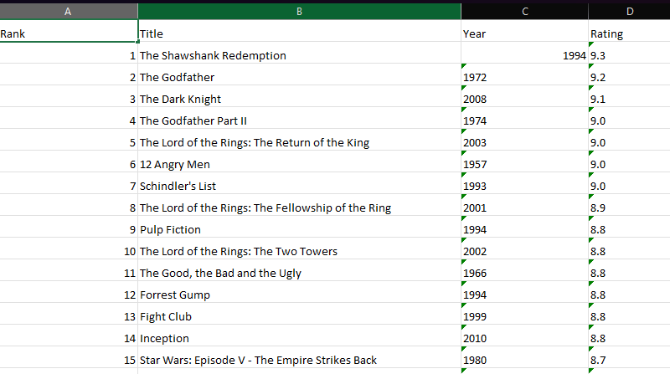
TEAM - 6
OUTPUT (CSV)

Slide 8
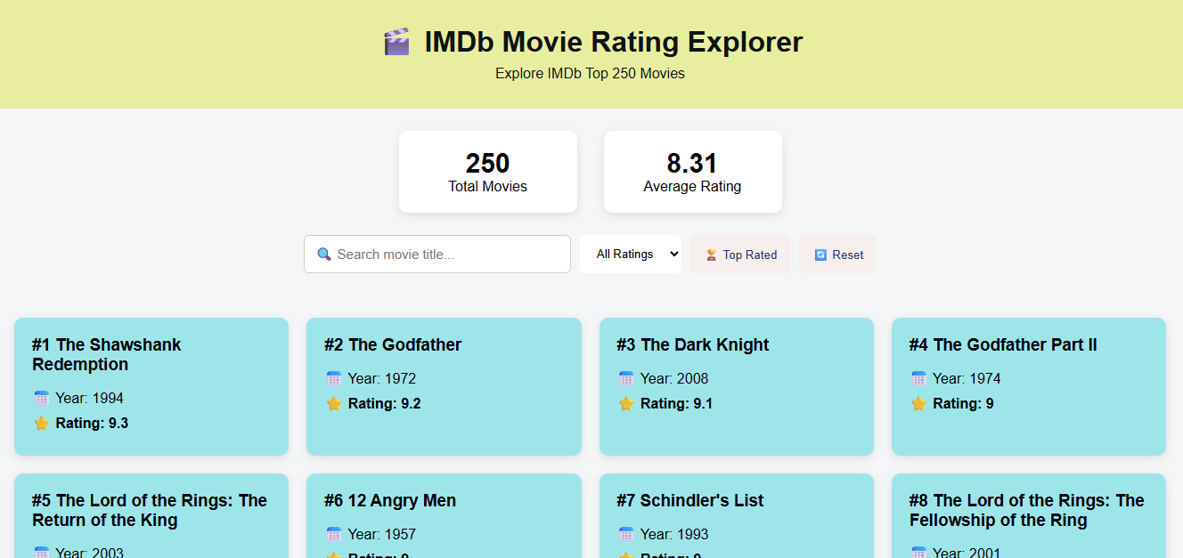
TEAM - 6
OUTPUT (web dashboard)

Slide 9
TEAM - 6
THANK YOU!!

